Slide 1

Design elements for network diagrams
CS Sprint 1 | Final Project

Slide 2
Instructions for the template
Do not change this file!
Create a copy of this file.
Use the elements from this file for your “Tempus Fugit” Project.
If you’ve deleted any icons or slides from your own copy, you can easily copy and paste necessary slides from here.
When you paste any text from another source, please use the “match destination formatting” option to keep your project’s style consistent.
Enjoy!

Slide 3
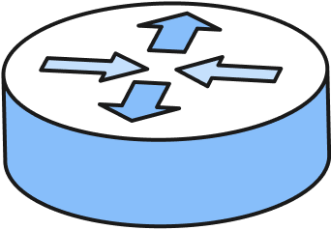
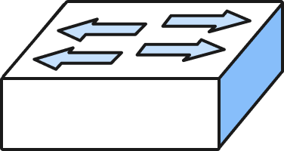
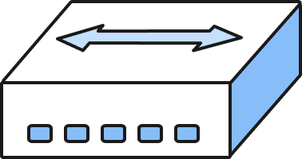
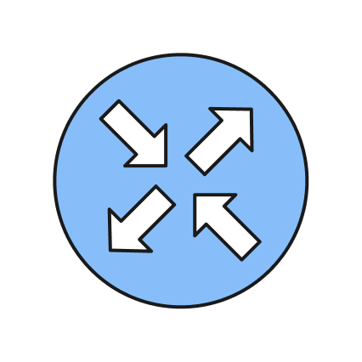
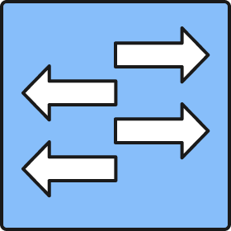
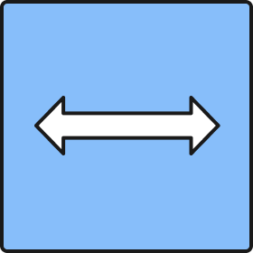

Devices
Router
Switch
Hub
If you need to make a complicated design, use these simplified icons to keep the diagram clean and readable

Slide 4
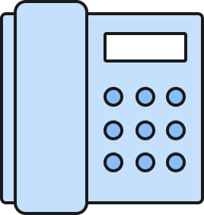
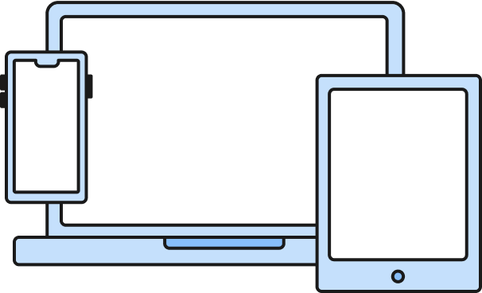
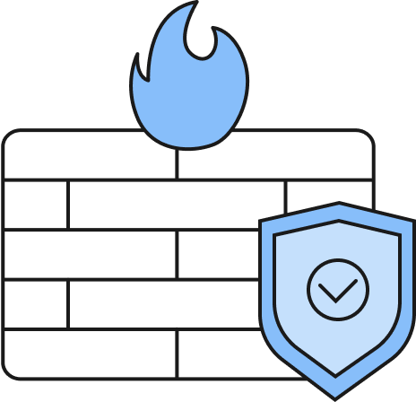
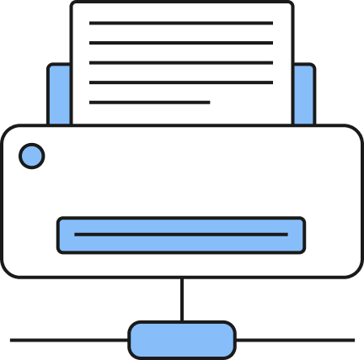
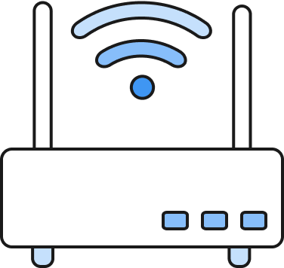
Devices
Phone
User Devices
Firewall
Wi-Fi access point
Printer

Slide 5

Topologies
Ring topology
Bus topology
Star topology

Slide 6
Topologies
Mesh topology
Hub-and-Spoke topology

Slide 7
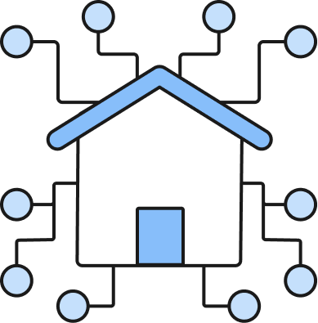
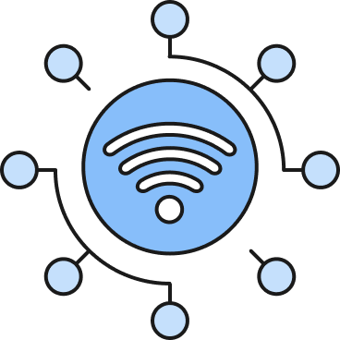

Area Networks
Internet (WAN)
Local Network (LAN)
Wireless Network (WLAN)
When you need to create connections between the networks, please use the following types of lines:
Wired network for WAN
Wired network for LAN
Wireless network for WLAN

Slide 8
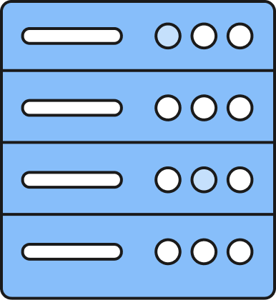
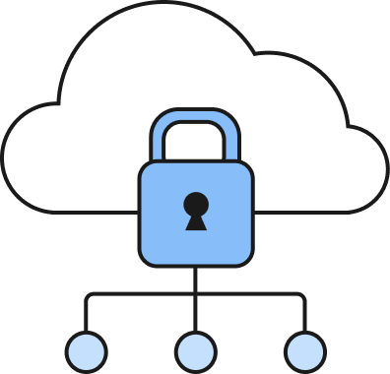
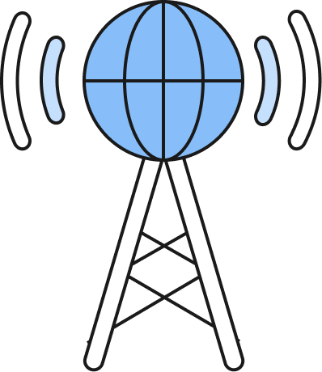
Service Providers
ISP
Data Center
Cloud Service Provider

Slide 9



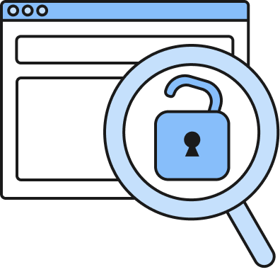
Continuous Monitoring
Network Observability
Endpoint Detection & Response (EDR)
Vulnerability Scan
No visibility into network

Slide 10

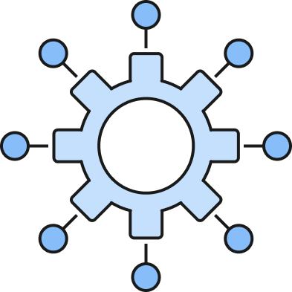
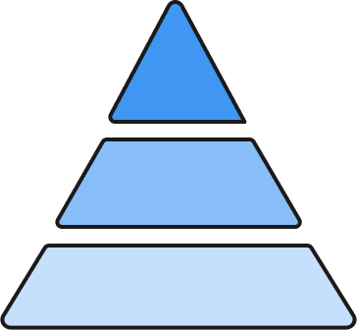
Architectures
Monolithic ERP
(Architecture)
Three-tier
(Architecture)
Cloud microservices
(Architecture)

Slide 11

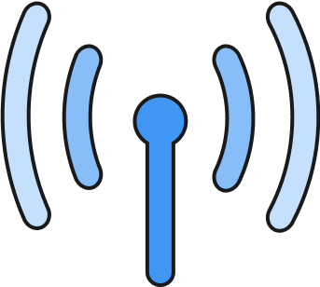


Connection Types
Wired connections
Wireless connections
High-speed Connection
Low-speed Connection
Wi-Fi Connection
Cellular Connection

Slide 12
Network Redesign
Building A
Building B
Building C
Building D

Slide 13
Documentation
Change Architecture from ERP to Three-Tier
Tempus Fugit growth being impeded by their current architecture; therefore, requires change for more room for company growth
This architecture has great confidentiality, integrity, and availability than ERP
Change Topology from Ring to Mesh
Tempus Fugit are having connection issue due to cable and network failure, so this change would solve those issue
The mesh method allows better integrity as it does not rely on a single connection between devices
Change LAN to WAN and added EDR
Gives IT more access to the status of all buildings
Gives employees access data remote if needed
Increase integrity as they can now monitor for suspicious activity
Tempus Fugit concerns about no having access to data without being
Upgrade routers
Modernize their routers for better connection and handle desired speeds
Added firewall for further security
Increase availability with less delay

